Slide 1


Dynotech Facebook Growth: Insights & Impact

Slide 2
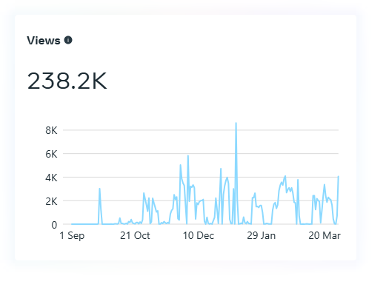
Views
We have been working with Dynotech from October 1, 2024, to March 1, 2025, and successfully gained 238,200 views.
The views are calculated based on the people who saw the content posted, whether they saw it through organic reach, reposts and shares, or from paid advertisements within those 6 months .

Slide 3
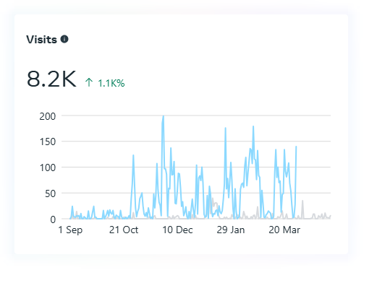
Visits
From all content views, Dynotech received 8200 page visits directly from posts.
This excludes individuals who clicked Dynotech's website links directly from the post
This excludes individuals who clicked a content or call button before visiting the page.

Slide 4
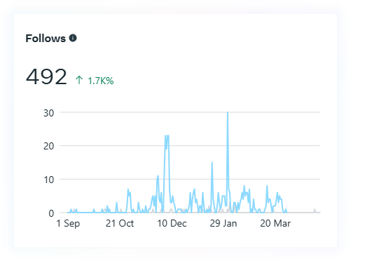
Follows
Dynotech gained 492 new followers on its interactive pages. Directly from its posts.

Slide 5
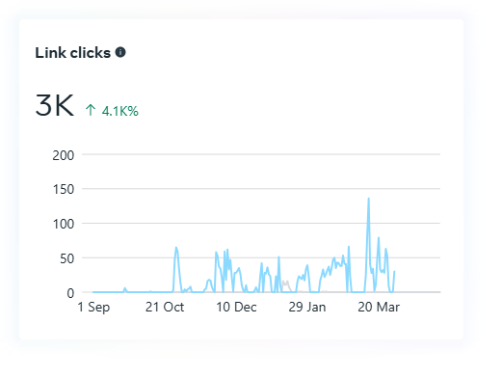
Link clicks
Dynotech received 3000 link clicks to their website from their posts

Slide 6
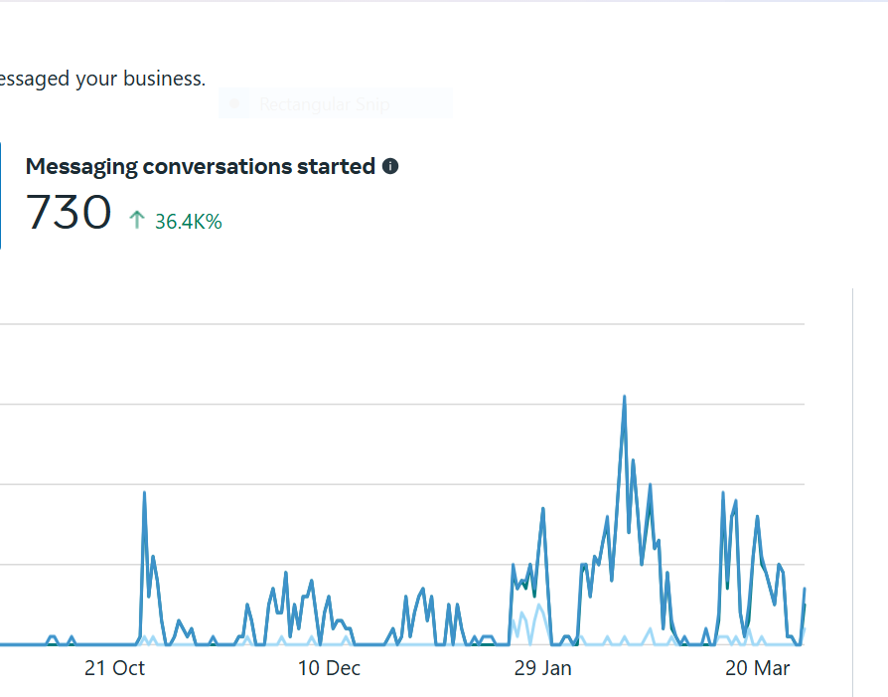
Contacts
730 messages and contacts were received directly from Facebook in this period
This excludes messages that came from website viewers

Slide 7
